Slide 1
Java IO: Pipes
A pipe connects an input stream and an output stream.
A piped I/O is based on the producer-consumer pattern, where the producer produces data and the consumer consumes the data.
In a piped I/O, we create two streams representing two ends of the pipe. A PipedOutputStream object represents one end and a PipedInputStream object represents the other end. We connect the two ends using the connect() method on the either object. We can also connect them by passing one object to the constructor when we create another object.
We can produce and consume data after we connect the two ends of the pipe.
We produce data by using one of the write() methods of the PipedOutputStream object. Whatever we write to the piped output stream automatically becomes available to the piped input stream object for reading.
We use the read() method of PipedInputStream to read data from the pipe. The piped input stream is blocked if data is not available when it attempts to read from the pipe.
A piped stream has a buffer with a fixed capacity to store data between the time it is written to and read from the pipe.
We can set the pipe capacity when we create it. If a pipe's buffer is full, an attempt to write on the pipe will block.
A pipe is used to transfer data from one thread to another. The synchronization between two threads is taken care of by the blocking read and write.
PipedOutputStream
PipedInputStream
Thread A
Producer
Write()
Read
Thread B
Consumer

Slide 2
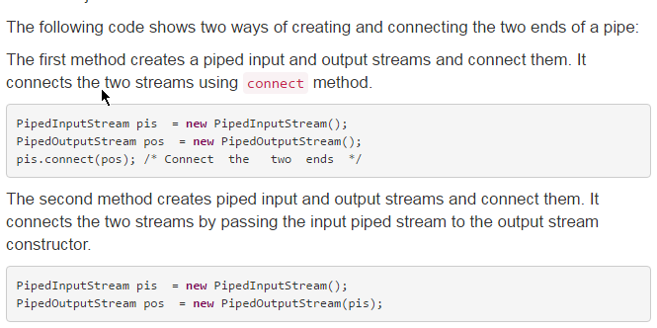
Java IO: Pipes

Slide 3
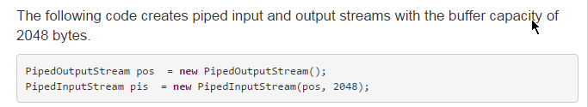
Java IO: Pipes

